Slide 1
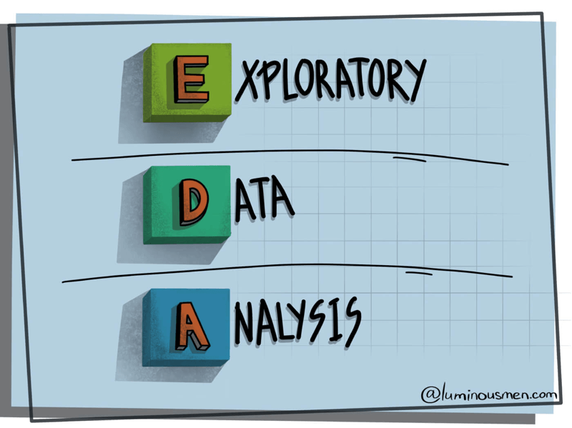
Exploratory Data Analysis
Deepak Mehta

Slide 2
Basic Intuition
Exploratory Data Analysis refers to the critical process of performing initial investigations on data so as
to discover patterns,
to spot anomalies,
to test hypothesis
to check assumptions
with the help of summary statistics and graphical representations.0

Slide 3
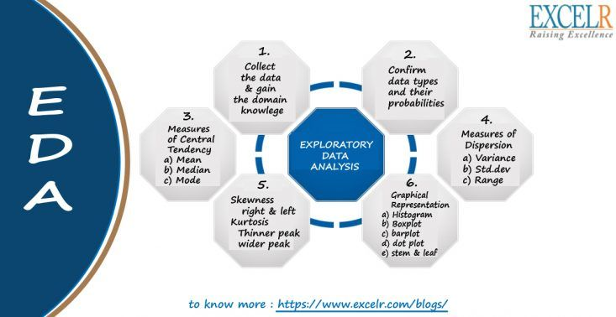

Slide 4

Gain Insight Knowledge
Syntax: dataframe.shape
Return : Returns tuple of shape (Rows, columns) of dataframe/series
Syntax: dataframe.ndim Return : Returns dimension of dataframe/series. 1 for one dimension (series), 2 for two dimension (dataframe)
Syntax: dataframe.size Return : Returns size of dataframe/series which is equivalent to total number of elements. That is rows x columns.

Slide 5

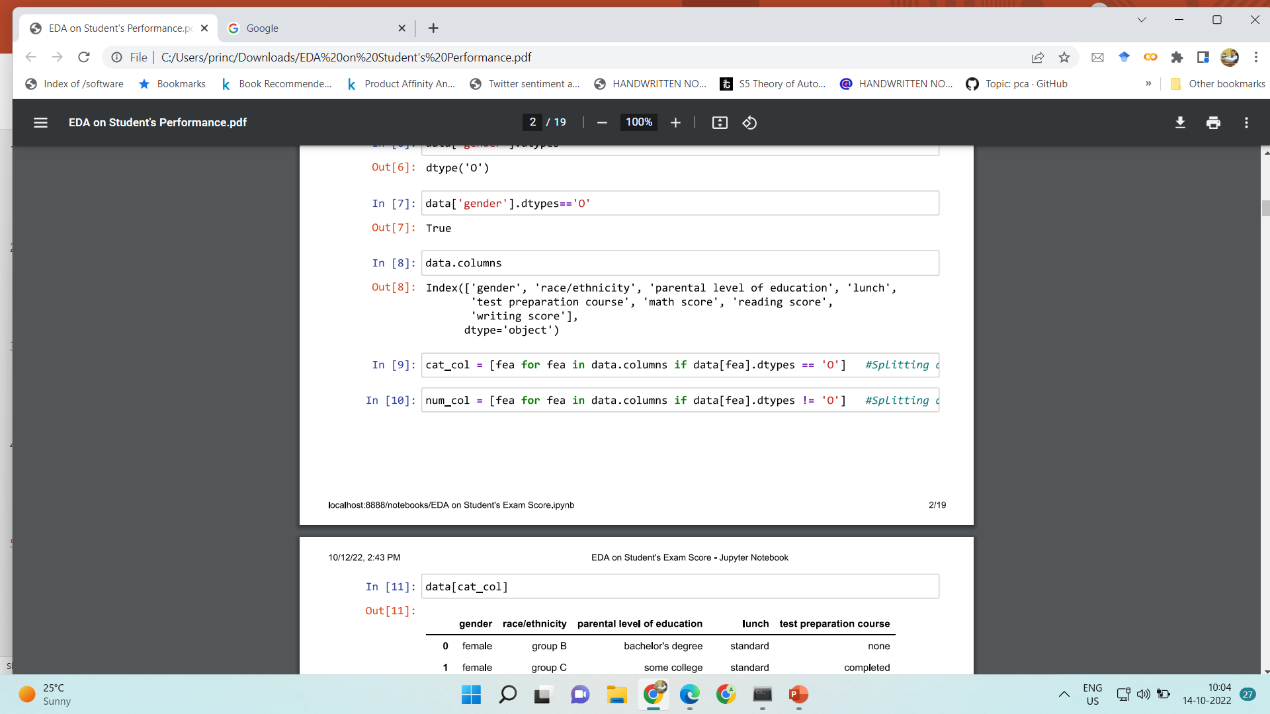
Categorical and Numerical Columns

Slide 6

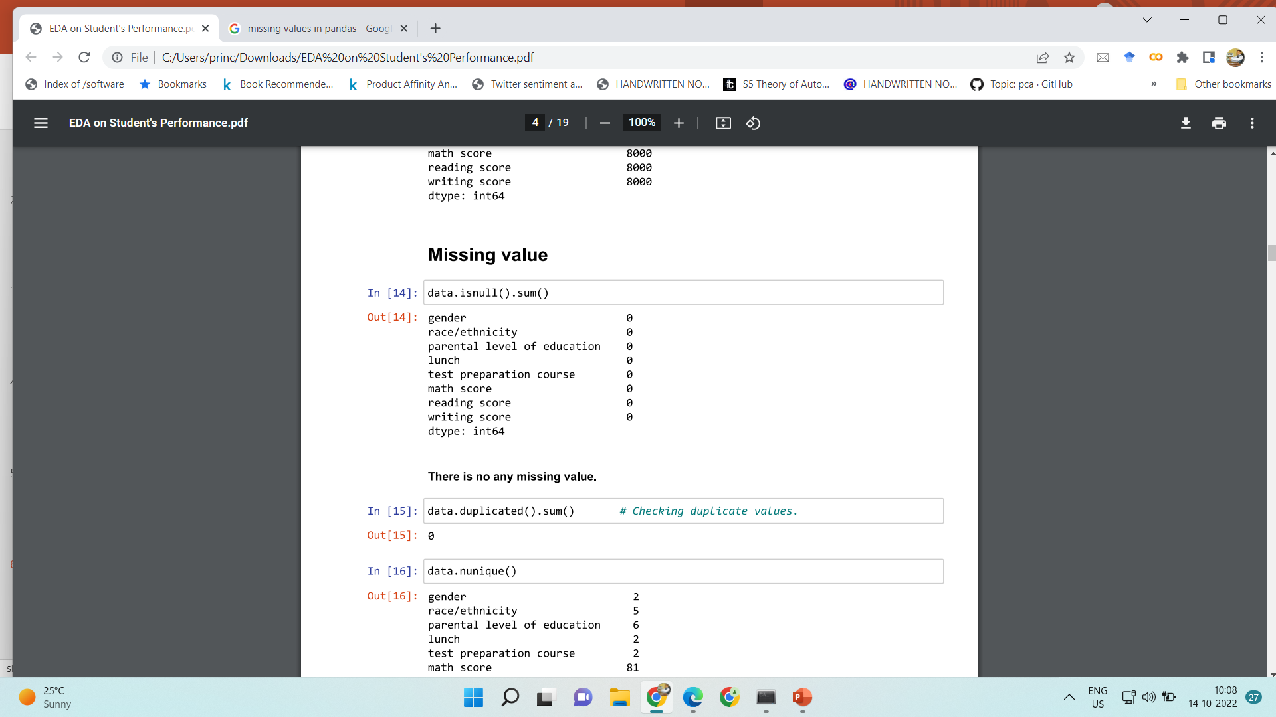
Missing Values Calculations

Slide 7
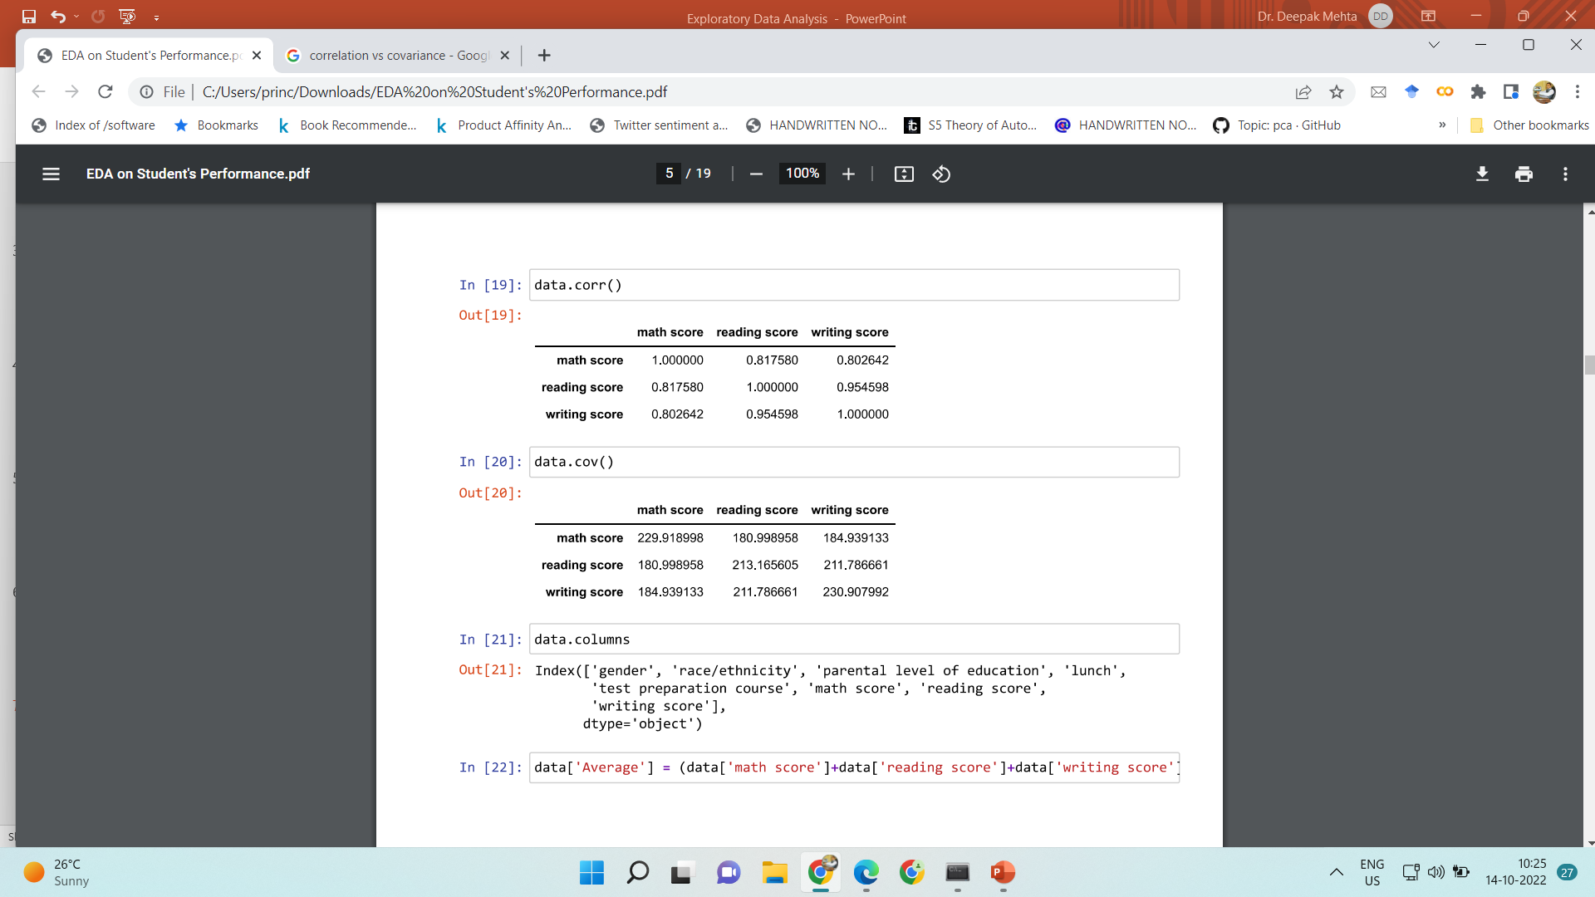
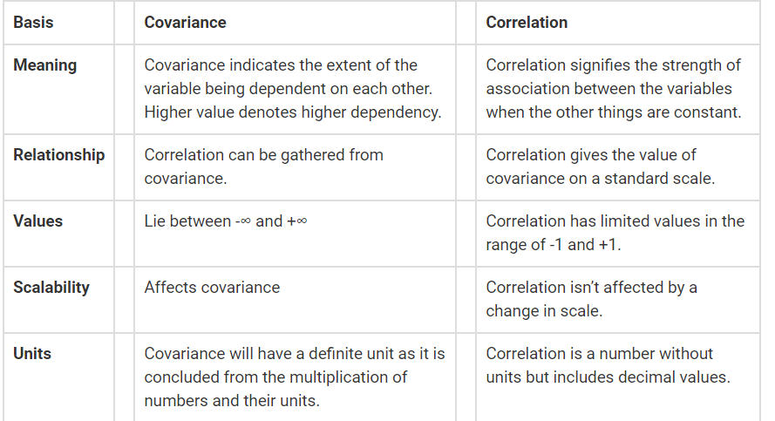
Correlation vs Covariance
Covariance indicates the linear relationship between variables while correlation measures the direction and strength of the linear relationship between variables.

Slide 8
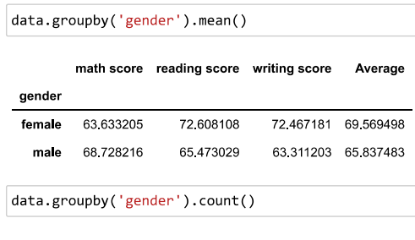
Group by

Slide 9

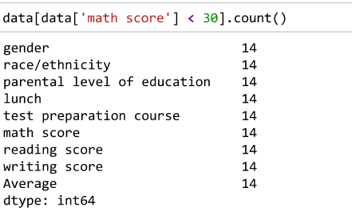
Filters

Slide 10
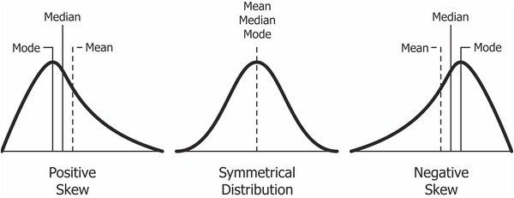
Skewness
Skewness is a measure of asymmetry of the probability distribution about its mean and helps describe the shape of the probability distribution.
Basically it measures the level of how much a given distribution is different from a normal distribution (which is symmetric)
Data.skew()

Slide 11
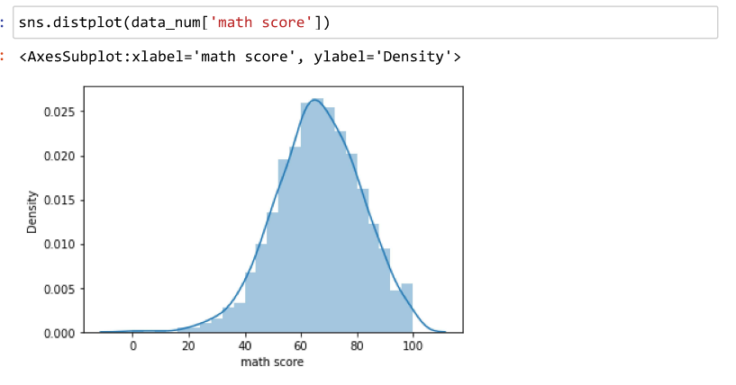
Distribution plot

Slide 12
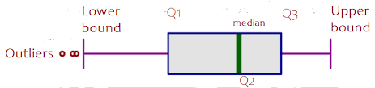
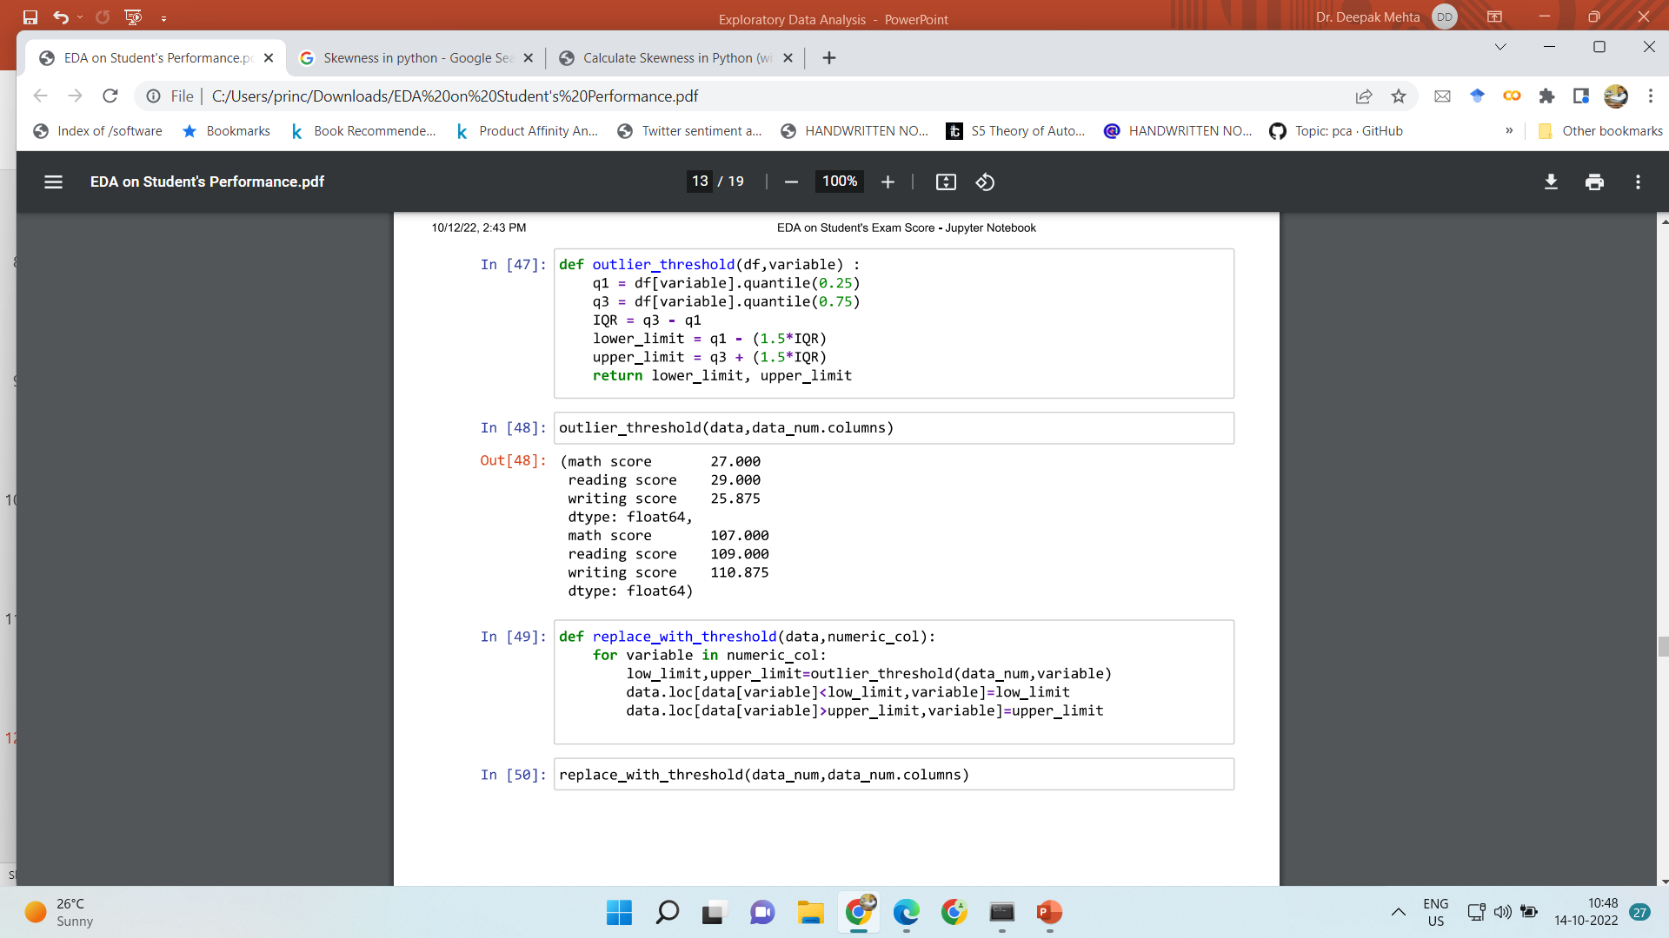
Outlier Detection

Slide 13
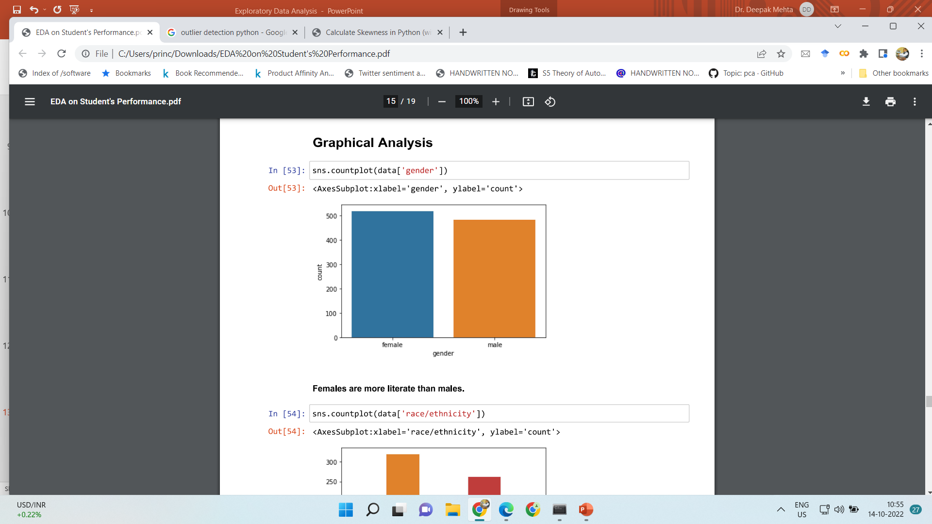
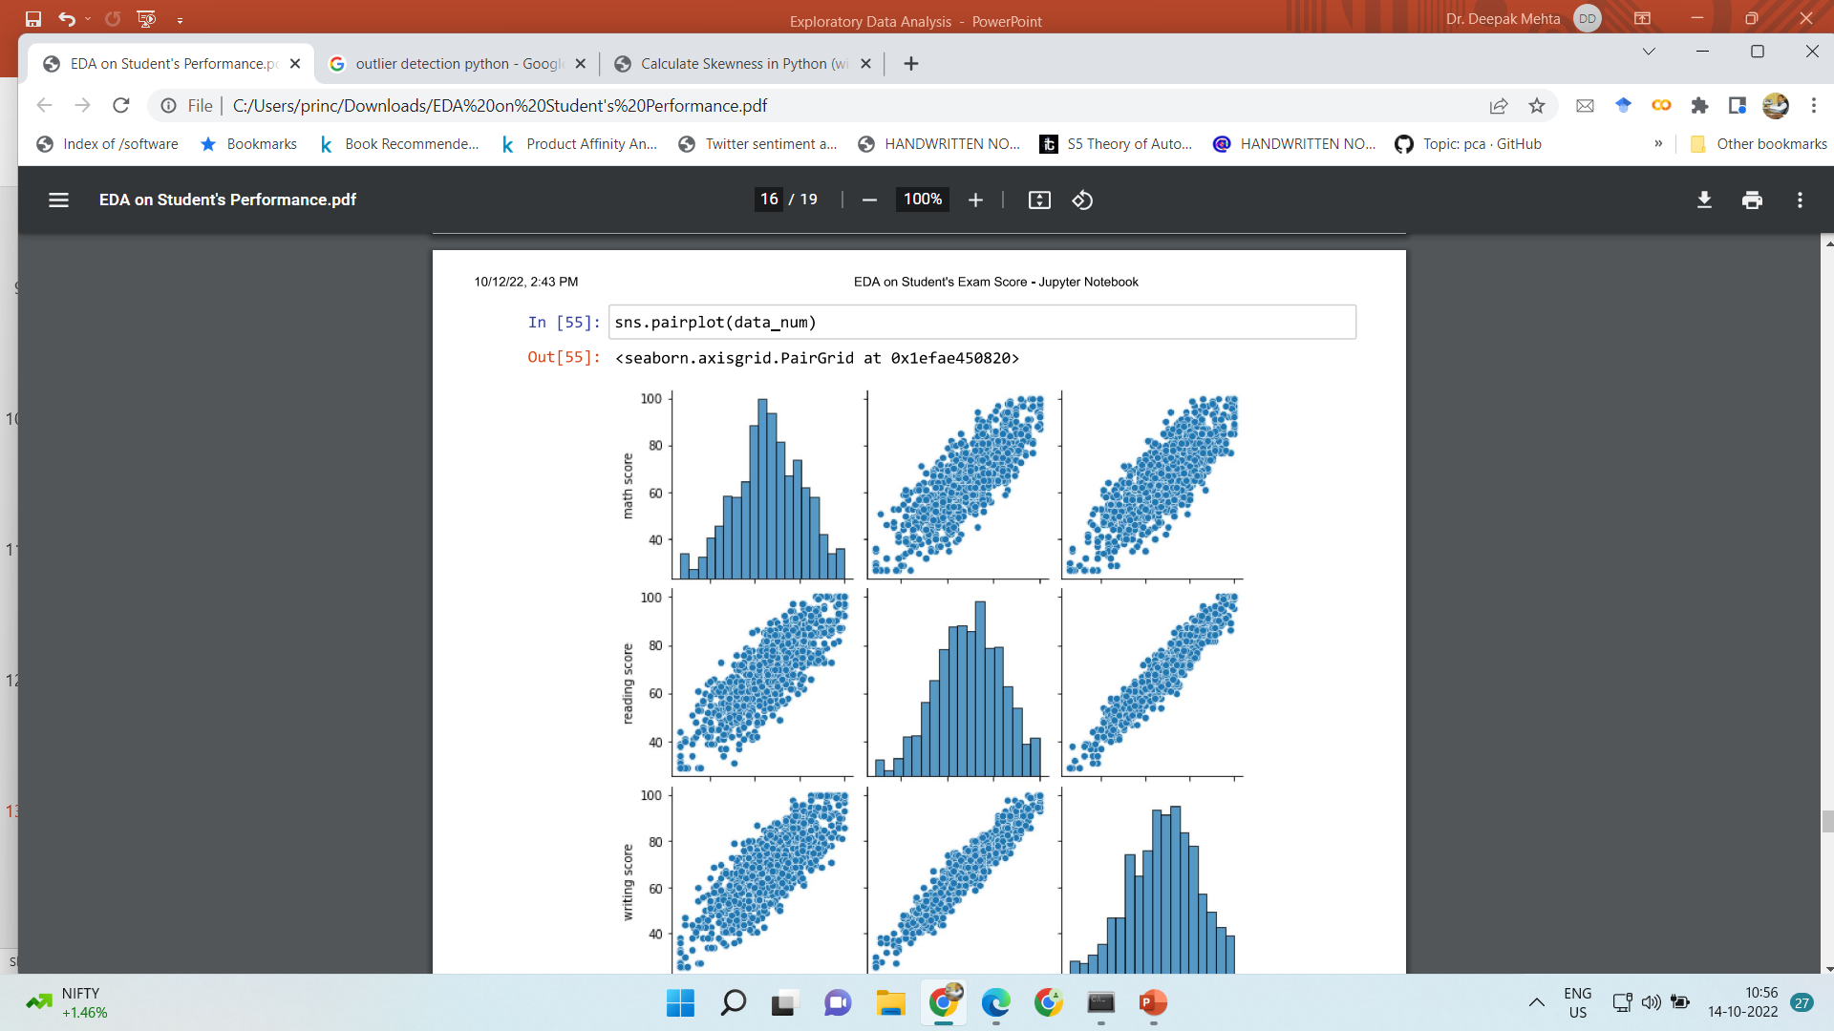
Graphical Analysis

Slide 14
Thanks
Deepak.e11296@cumail.in
9812881611

